Slide 1
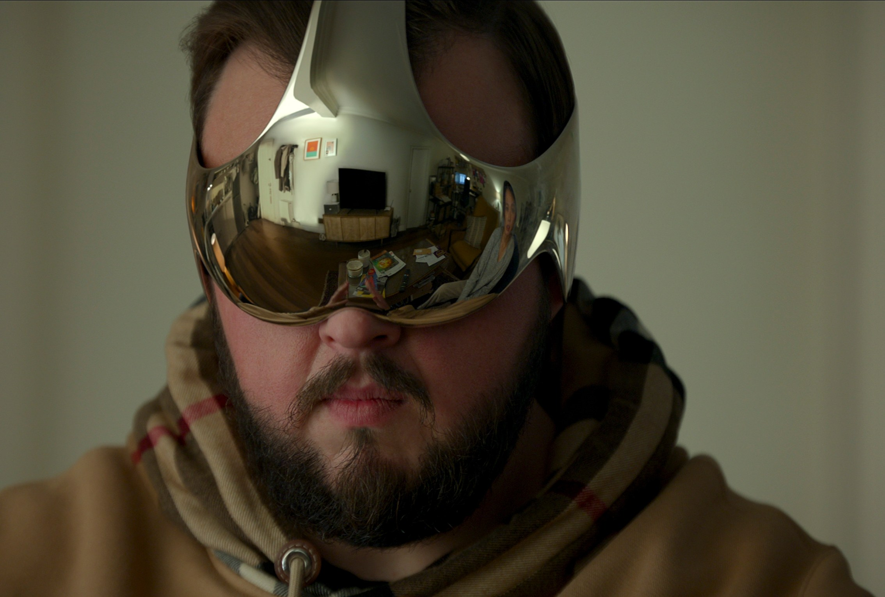

Computer Graphics
Lecture 19: VR and conclusion
Kartic Subr

Slide 2
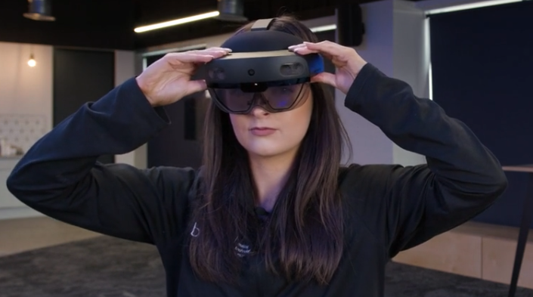
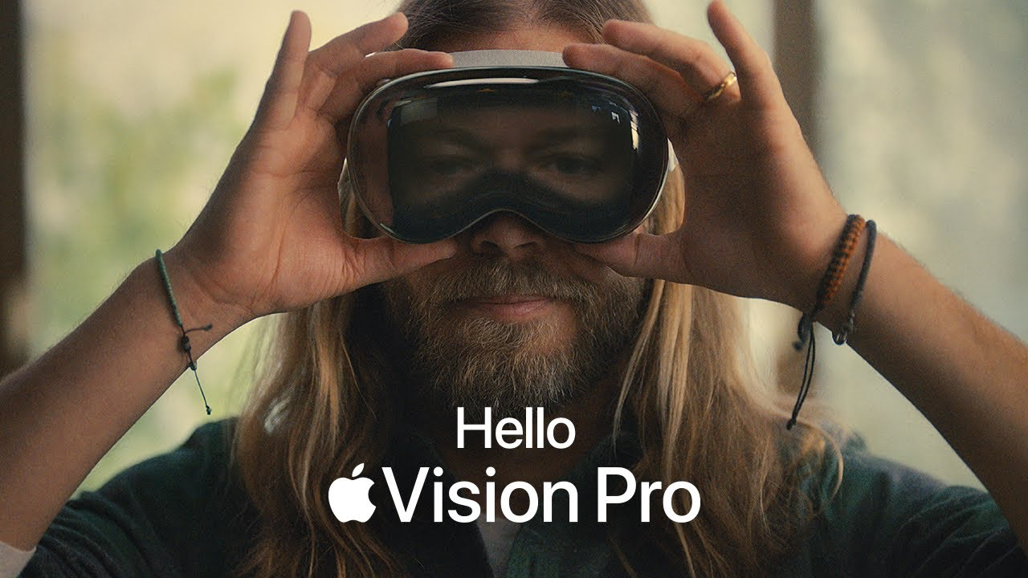
https://virtualspeech.com/blog/history-of-vr

Slide 3
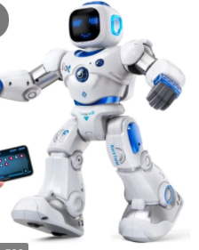
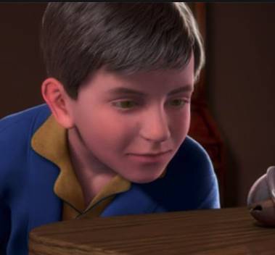

Slide 4
The uncanny valley [Masahiro Mori 1970]

Slide 5
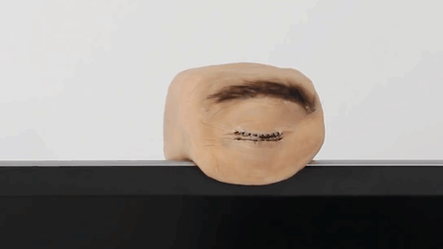
The uncanny valley [Masahiro Mori 1970]

Slide 7
VR systems
Human stereo vision
Display technology
Low-latency stereo rendering algorithm
Haptic feedback
VR smell
Stereo/surround sound

Slide 8
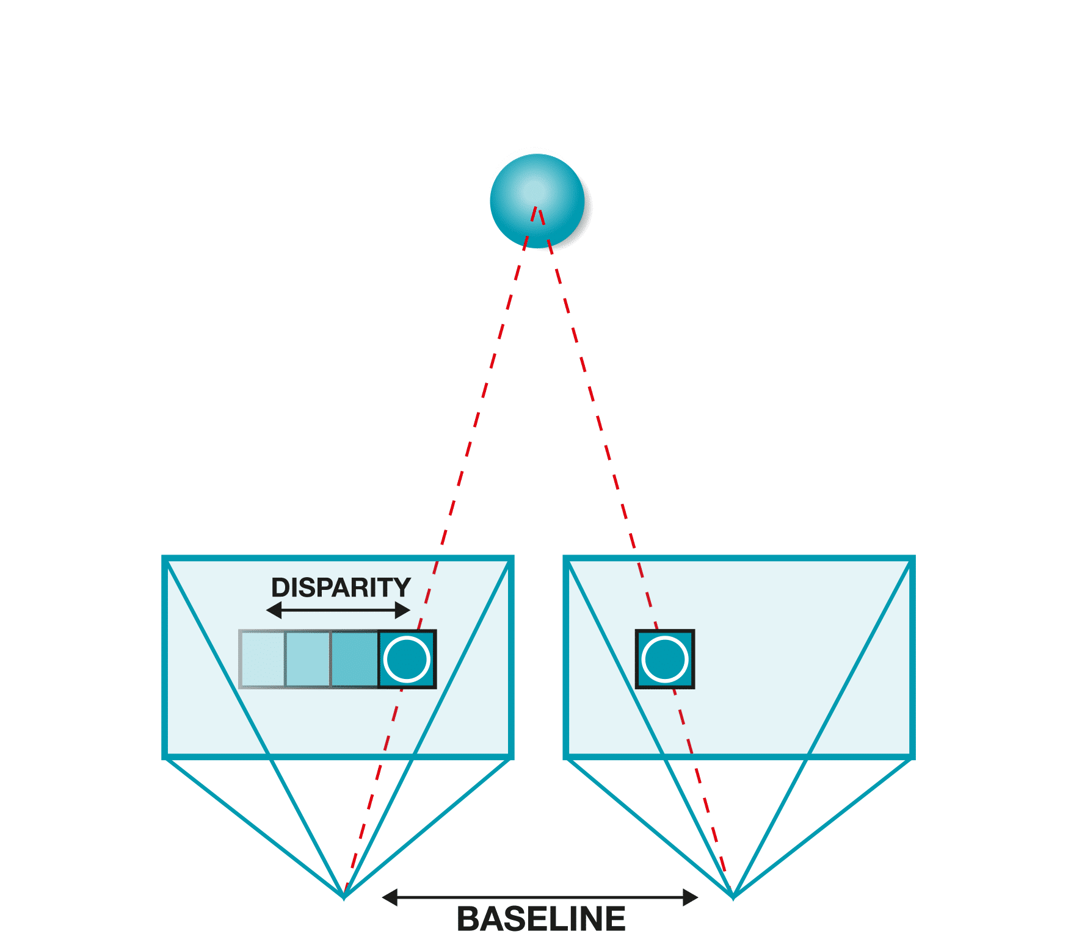
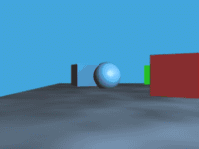
Stereopsis
parallax

Slide 9
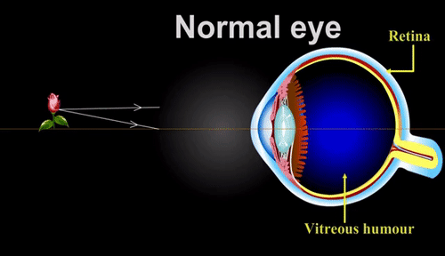
Focus

Slide 10
Conflict – flat stereo displays

Slide 11
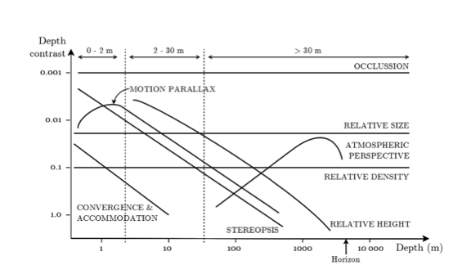
Depth perception
cutting and vishton 1995

Slide 12
Visual Field
https://www.lecturio.com/concepts/the-visual-pathway-and-related-disorders/

Slide 13
Visual System - considerations

Slide 14
VR systems
Human stereo vision
Display technology
Low-latency stereo rendering algorithm
Haptic feedback
VR smell
Stereo/surround sound

Slide 15
3D displays?

Slide 16
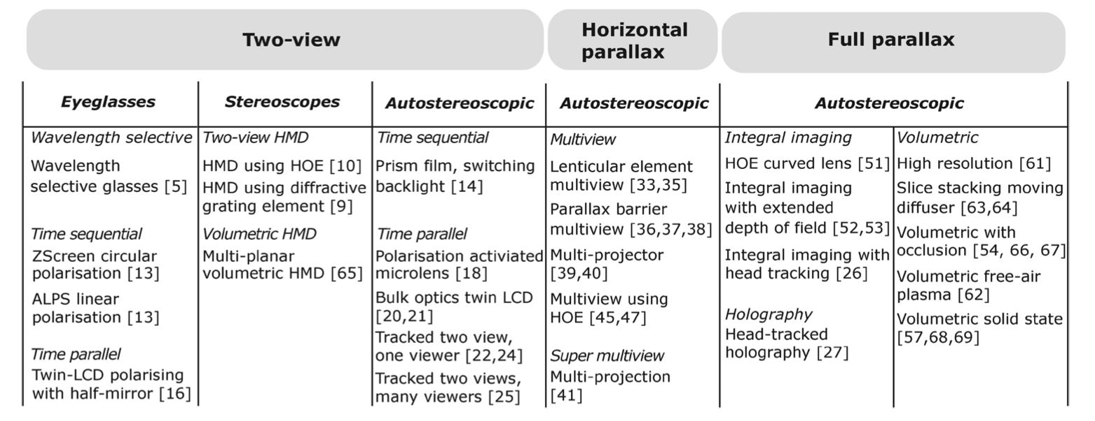
3D displays
Holliman et al 2011

Slide 17
Stereo displays

Slide 18
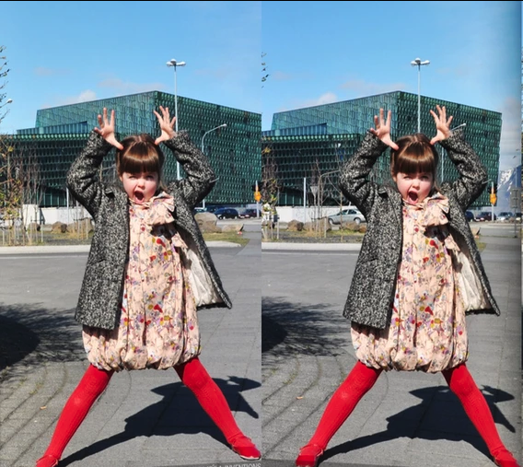
Stereo displays
Side-by-side images
wall-eyed
cross-eyed
Stereoscopes
Anaglyphs
Polarisation
Eclipse (active shutters)
Interference
Autostereoscopy
https://www.kula3d.com/how-to-use-the-cross-eyed-method

Slide 19
Stereo displays
Side-by-side images
wall-eyed
cross-eyed
Stereoscopes
Anaglyphs
Polarisation
Eclipse (active shutters)
Interference
Autostereoscopy
19th century

Slide 20
Stereo displays
Side-by-side images
wall-eyed
cross-eyed
Stereoscopes
Anaglyphs
Polarisation
Eclipse (active shutters)
Interference
Autostereoscopy

Slide 21
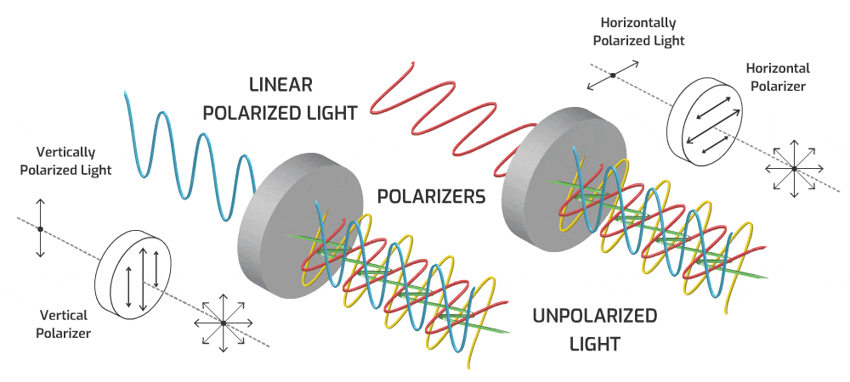
Stereo displays
Side-by-side images
wall-eyed
cross-eyed
Stereoscopes
Anaglyphs
Polarisation
Eclipse (active shutters)
Interference
Autostereoscopy
circularly polarised

Slide 22
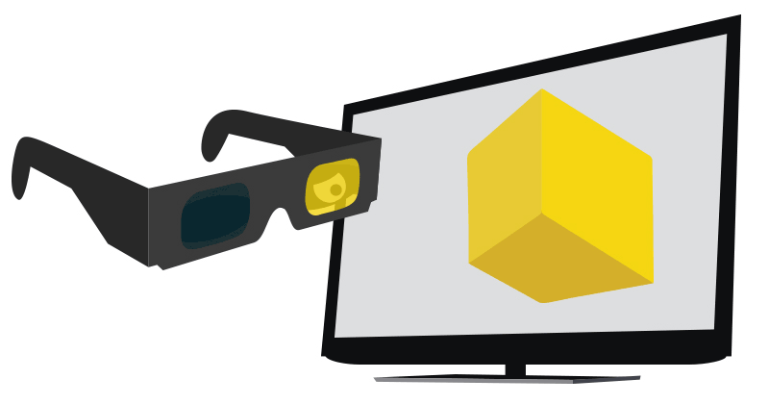
Stereo displays
Side-by-side images
wall-eyed
cross-eyed
Stereoscopes
Anaglyphs
Polarisation
Eclipse (active shutters)
Interference
Autostereoscopy

Slide 23
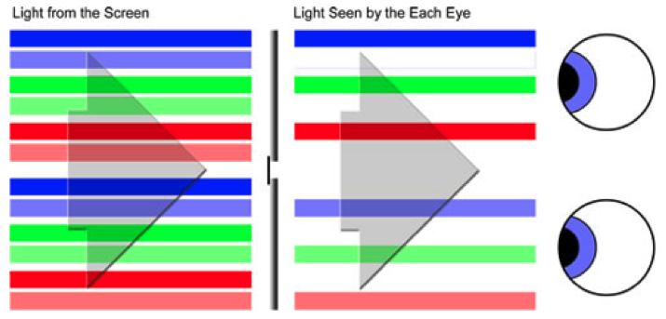
Stereo displays
Side-by-side images
wall-eyed
cross-eyed
Stereoscopes
Anaglyphs
Polarisation
Eclipse (active shutters)
Chromatic/Interference
Autostereoscopy

Slide 24
Stereo displays
Side-by-side images
wall-eyed
cross-eyed
Stereoscopes
Anaglyphs
Polarisation
Eclipse (active shutters)
Chromatic/Interference
Autostereoscopy

Slide 25
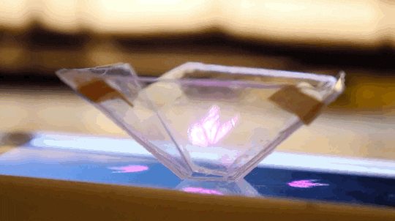
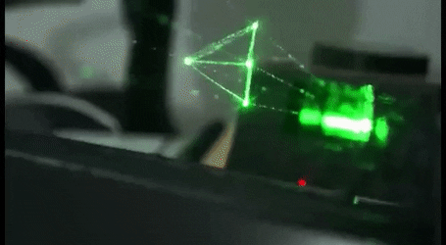
Holographic displays

Slide 26
Head mounted displays

Slide 27
VR systems
Human stereo vision
Display technology
Low-latency stereo rendering algorithm
Haptic feedback
VR smell
Stereo/surround sound

Slide 28
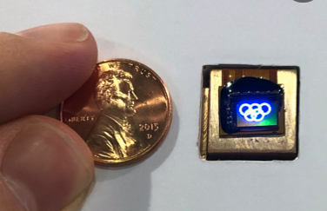
Stereo rendering for HMDs
micro-display

Slide 29
Most HMDs are simple magnifiers
micro-display

Slide 30
Single view – centred scene
y
z

Slide 31
Single view – symmetric view frustum
y
side view
z

Slide 32
Two views ?
shift only
shift and rotate
http://paulbourke.net/stereographics/stereorender/

Slide 33
Two views ?
creates vertical parallax
off-axis
toe-in
http://paulbourke.net/stereographics/stereorender/

Slide 34
Two views ?
creates vertical parallax
off-axis
toe-in
http://paulbourke.net/stereographics/stereorender/

Slide 35
Two views – asymmetric frusta
x
side view
z

Slide 36
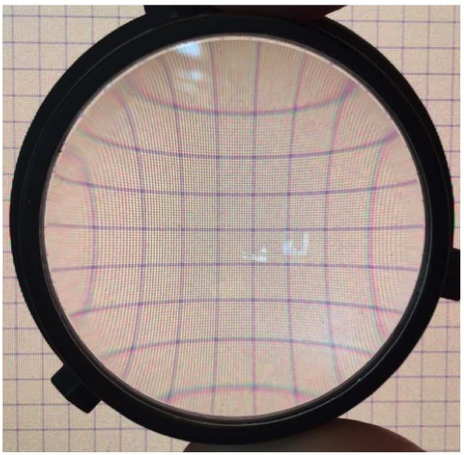
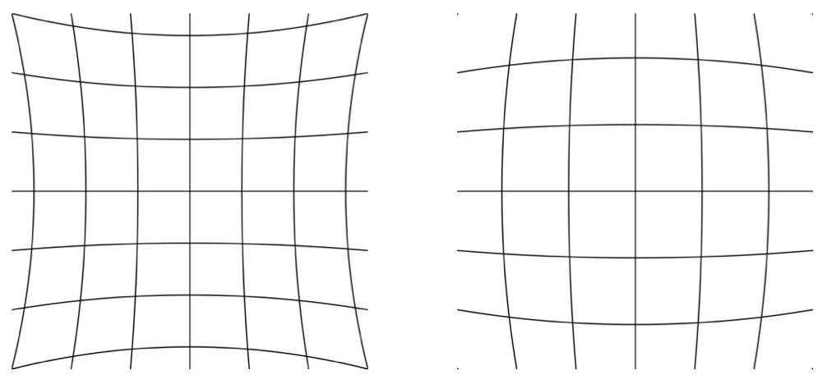
Lens distortion
pin-cushion distortion
barrel distortion

Slide 37
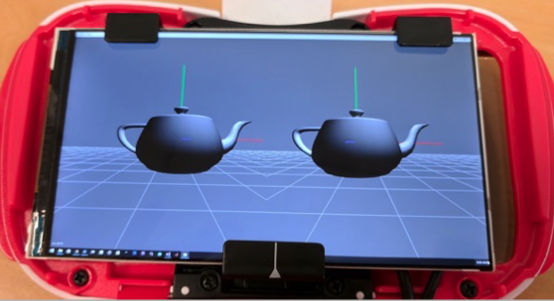
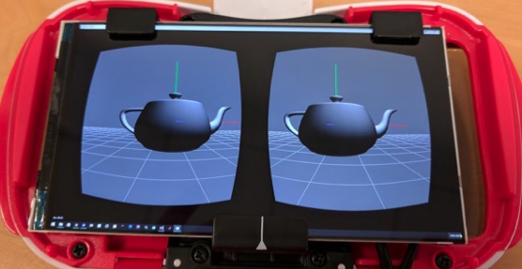
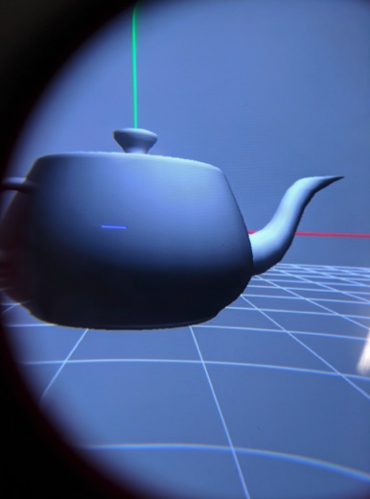
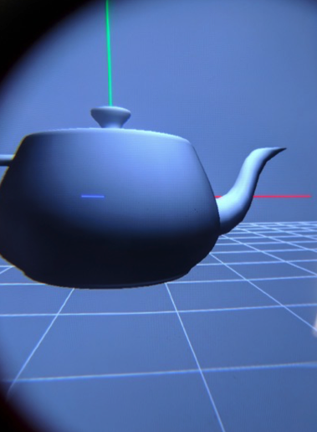
Lens distortion correction

Slide 38
https://virtualspeech.com/blog/history-of-vr

Slide 39
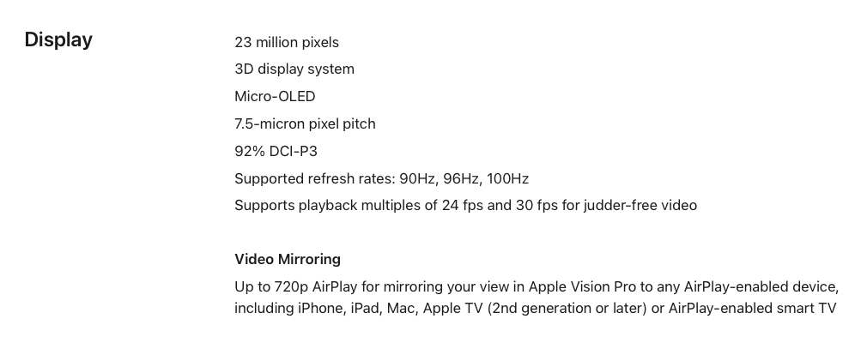
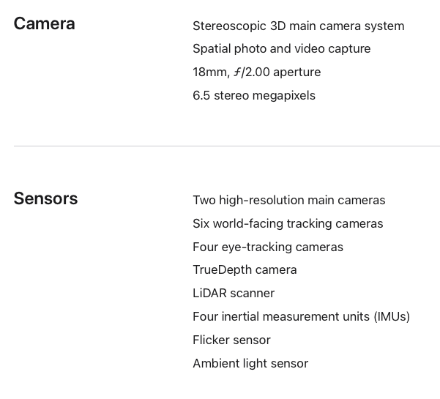
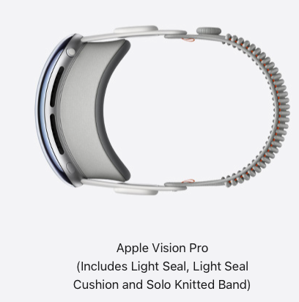


Slide 40
Interested readers …
https://stanford.edu/class/ee267/syllabus.html

Slide 41
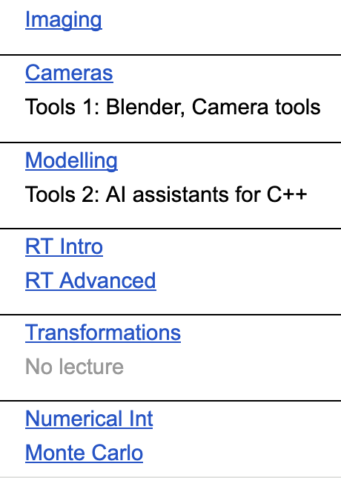
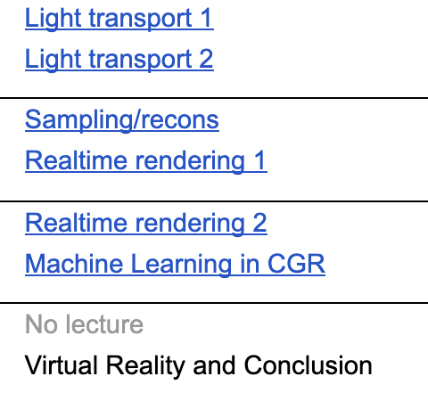
This course …
Not assessed

Slide 42

Feedback please …

Slide 43



Feedback/nomination
1) course survey
2) If you liked the course
https://forms.office.com/e/b2biUiYfuP
teaching.awards@eusa.ed.ac.uk
https://www.eusa.ed.ac.uk/whatson/awards/teachingawards/faqs
(cookies trouble? try it in an incognito window)

